Slide 1
Data Structures
Introduction

Slide 2
Data
In computer science Data is description of any (physical) entity that can be stored in computer’s memory.
It is an exact value or set of values.
Data represents an abstraction of reality in the sense that certain properties and characteristics of the real objects are ignored because they are peripheral and irrelevant to the particular problem

Slide 3
Data
Real world data – are physical entities external to computer. A non computer example of real world data storage may be set of index cards which are, say, used for storing a person’s Name, Address and Phone No. Functions like Insertion, Deletion, Sorting, Searching etc may be performed on the set of cards
Files which are created in computers for daily use, information which is found on internet or data which are stored at servers of business organizations can be considered as the computer example of data

Slide 4
Data Structure
A Data Structure is an arrangement of data in computer’s memory.
To know how information is organized in a computer’s memory (Core), how it is or it can be manipulated and how it can be used.
The logical or mathematical model of a particular organization of data is called Data Structure.
The data model should be rich enough in structure to mirror the actual relationships of data in real world and on the other hand it should be simple enough that one can easily process the data when necessary.

Slide 5
Data Structure
Useful in reducing the complexity and increasing the efficiency of the program being developed.
Helps us in understanding the relation of one data element with another and its organization within the computer memory.
Examples : Array, stack, Linked List, Hash Table, Heap etc.
Operations: Traversing, Searching, Insertion, Deletion etc. Along with certain special operations like Sorting, Merging, Copying, Concatenation etc.

Slide 6
Data Type
Data type is a collection of values and a set of operations on those values.
A data type determines the set of values to which a constant belongs, or which may be assumed by a variable or an expression, or which may be generated by an operator or a function.
The declaration specifies how much memory is needed for a particular entity, how the contents of the memory are to be interpreted, and other vital details.

Slide 7

Data Type
Data type is a method of interpreting memory contents of a computer.
For example: int x ;
Here 'x’ is a variable which will hold a value of integer type only and (generally) 2 or 4 bytes of memory will be allocated for it.
Data Type
Data Value
Identifier

Slide 8
Identifier / Mnemonic / Variable

Slide 9
Common Data Types
Character
Integer
Real
Float
Double
Boolean
String

Slide 10
Abstract Data Type
Abstract Data Type is a useful tool for specifying the logical properties of a data type
Fundamentally, data type is a collection of values and a set of operations on those values. That collection and those operations form a mathematical construct that may be implemented using a particular hardware or software data structure.
The term “Abstract Data Type” refers to basic mathematical concept that defines the data type.

Slide 11
Abstract Data Type
By specifying the mathematical and logical properties of a data type, the ADT is a useful guideline to implementers (and programmers) who wish to use that data type correctly.
Abstract Data Type can be assumed to be a triplet as
{D, F, A}
where
D refers to Data
F refers to Functions or operations on that particular data.
A refers to Axioms (are basic logical or mathematical facts which are always considered to be true, without asking for a proof.)

Slide 12
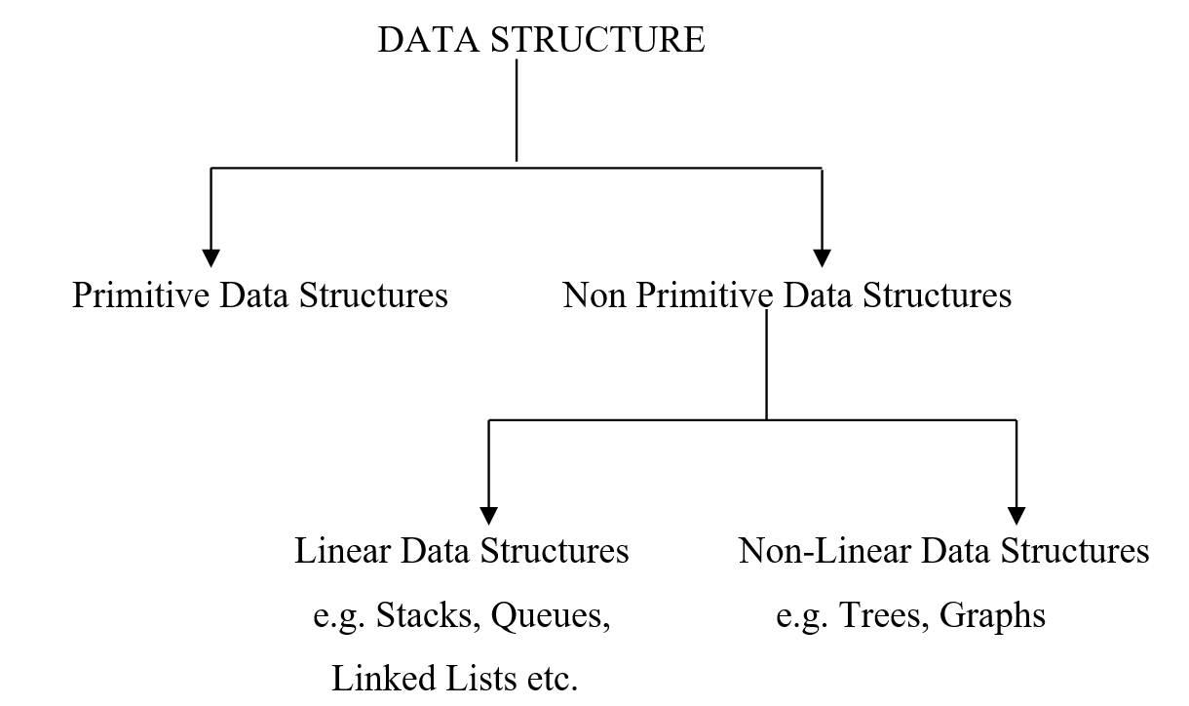
Classification of Data Structures
(Primitive = Simple, Atomic, Built in, System Defined, Hardware Implemented, Predefined, Basic)

Slide 13
End

